Slide 1

Find a friend. Date a friend. Why strangers?

Slide 2
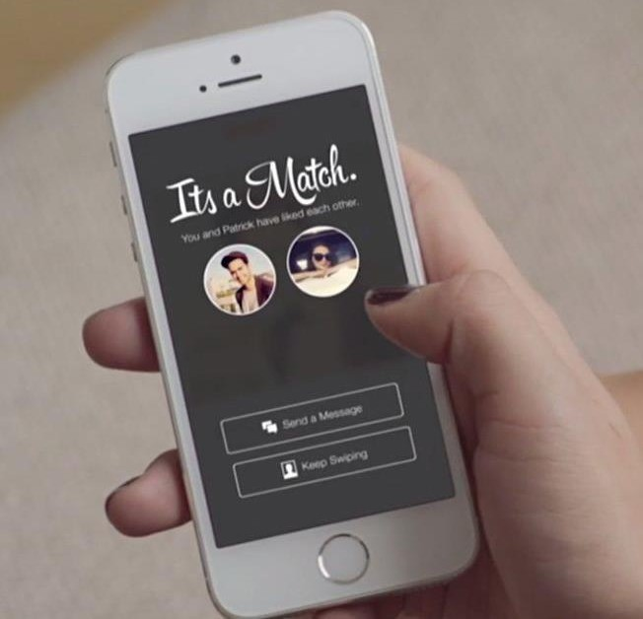
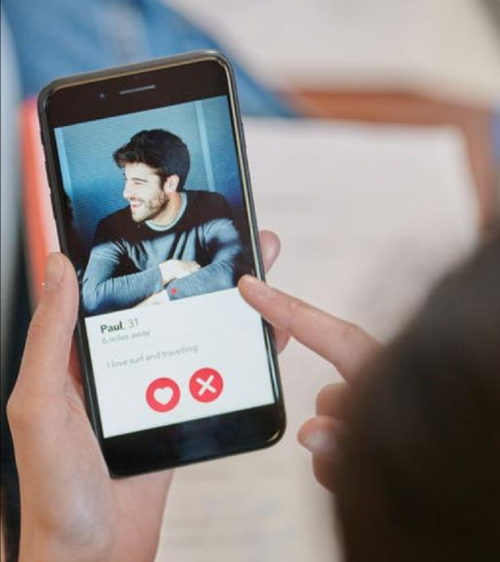
Introducing
The First
Socio-Dating App
BeYu is the first one of its kind , a socio-dating app that provides matches with friends or with mutual friends only therefore no matching with strangers anymore with a proper authenticity of data and one can see the profile before sending a match and networking socially at the same time thus making more friends.

Slide 3
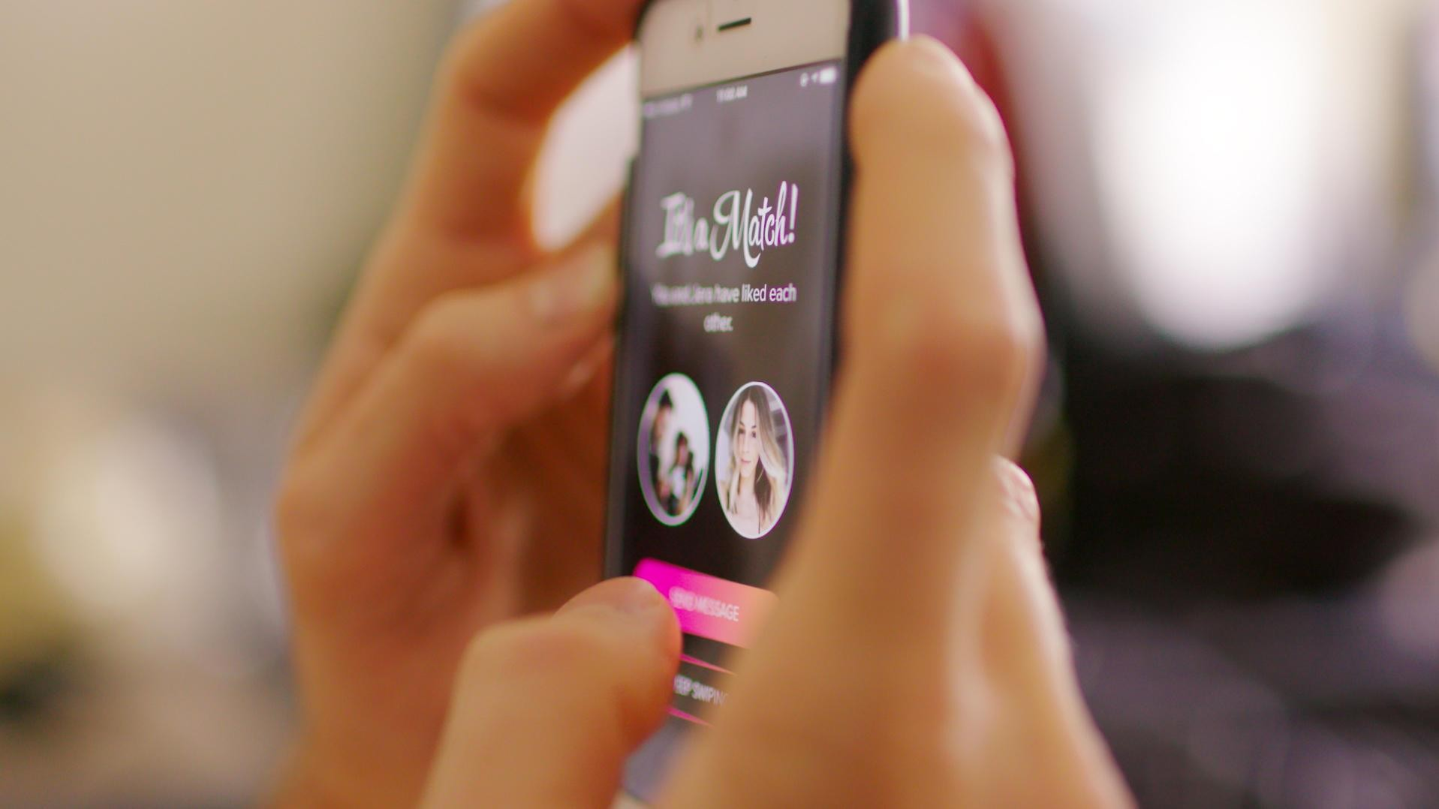

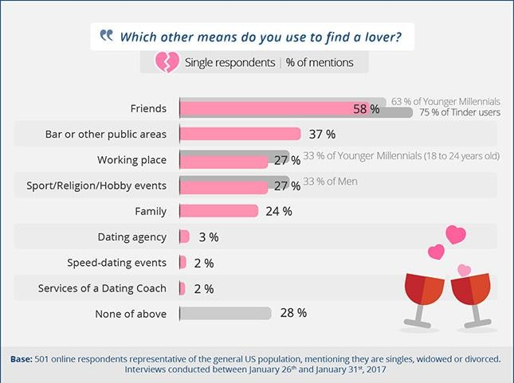
What is the Problem?
Is there any platform that enables match making within the peer or mutual friend circle?
- Users usually land up on online dating apps to look for a meaningful relationships and to expand their social circles. But are the existing dating platforms the right place to build this socio circle?
- Existing Application or platforms provide match making only with strangers. What if one wants a match within his/her social circle!?
Friends (58%) + Family (24%) = 82% Need BeYu

Slide 4
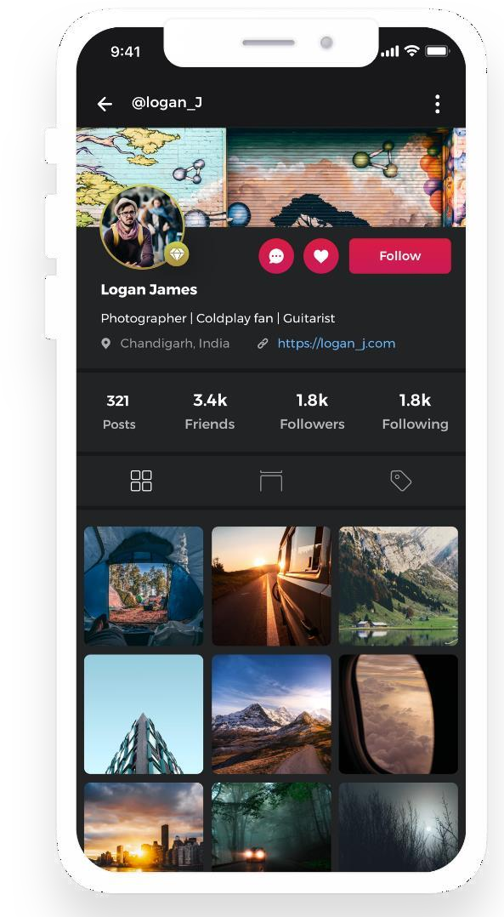
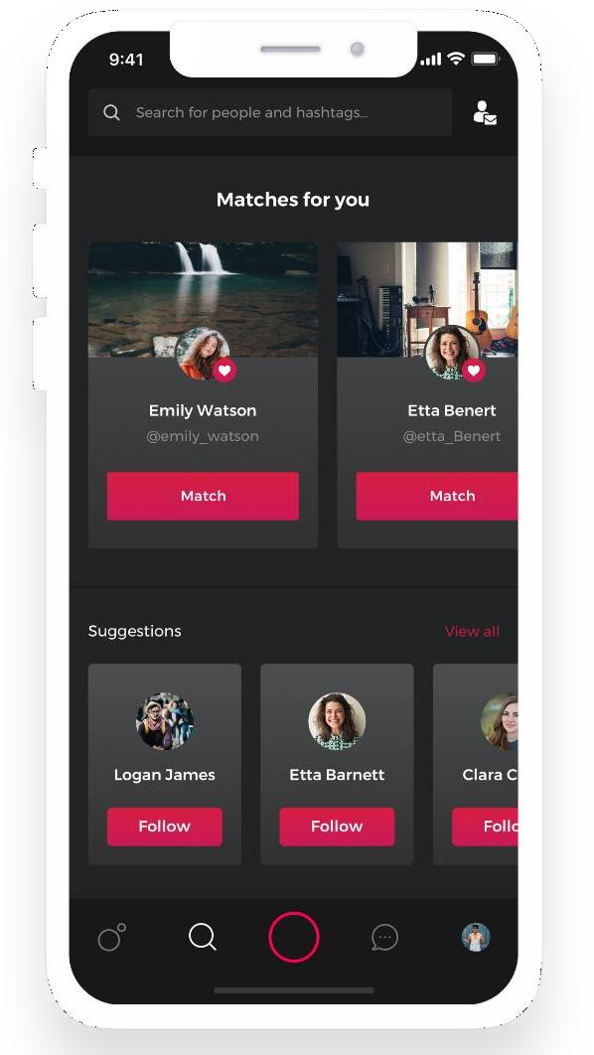
Our Concept
Key Features
Users can connect with their
friends or make new friends.
Let users to match with known people or the people they like.
Get matches from friends
Of friends or Searchfor the people you like and send a match, if they like you as well then get connected.
Users can chat with anyone.
Allows users to chat anonymously.
One can capture and share photos and videos with friends or with the people they like.

